Slide 1
Algorithms and Applications
ITCS4145/5145, Parallel Programming B. Wilkinson Spring 2009.
slides10-<number>

Slide 2
Areas done in textbook:
• Sorting Algorithms
• Numerical Algorithms
• Image Processing
• Searching and Optimization

Slide 3
Chapter 10
Sorting Algorithms
- Rearranging a list of numbers into increasing (strictly non-decreasing) order.

Slide 4

Potential Speedup
O(nlogn) optimal for any sequential sorting algorithm without using special properties of the numbers.
Best we can expect based upon a sequential sorting algorithm using n processors is
Has been obtained but the constant hidden in the order notation extremely large.

Slide 5
General note
Sorting requires moving numbers from one place to another in a list.
The following algorithms concentrate upon a message –passing model for moving the numbers.
Sorting number is important in applications as it can make subsequent operations more efficient

Slide 6
Compare-and-Exchange Sorting Algorithms
Compare and Exchange
Form the basis of several, if not most, classical sequential sorting algorithms.
Two numbers, say A and B, are compared. If A > B, A and B are exchanged, i.e.:
if (A > B) {
temp = A;
A = B;
B = temp;
}

Slide 7
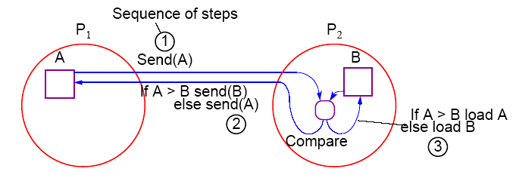
Message-Passing Compare and Exchange
Version 1
P₁ sends A to P₂, which compares A and B and sends back B to P₁ if A is larger than B (otherwise it sends back A to P₁):

Slide 8
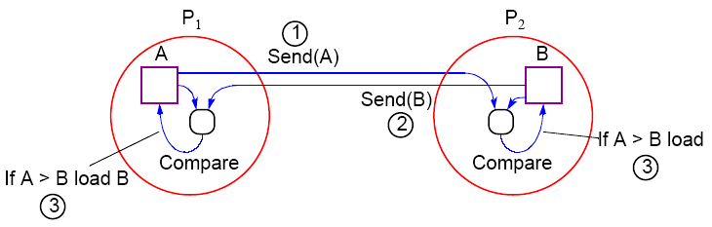
Alternative Message Passing Method
Version 2
For P₁ to send A to P₂ and P₂ to send B to P₁. Then both processes perform compare operations. P₁ keeps the larger of A and B and P₂ keeps the smaller of A and B:

Slide 9
Note on Precision of Duplicated Computations
Previous code assumes that the if condition, A > B, will return the same Boolean answer in both processors.
Different processors operating at different precision could conceivably produce different answers if real numbers are being compared.
This situation applies to anywhere computations are duplicated in different processors to reduce message passing, or to make the code SPMD.

Slide 10
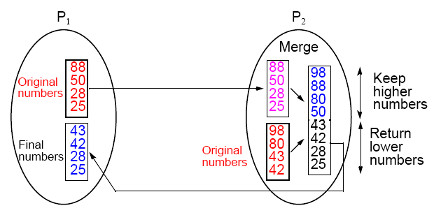
Data Partitioning
(Version 1)
p processors and n numbers. n/p numbers assigned to each
processor:

Slide 11
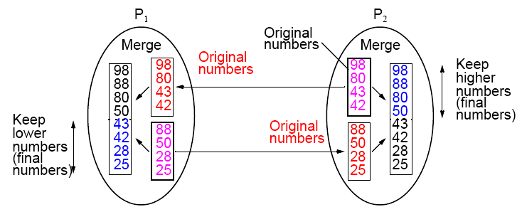
Merging Two Sublists — Version 2

Slide 12
Bubble Sort
First, largest number moved to the end of list by a series of
compares and exchanges, starting at the opposite end.
Actions repeated with subsequent numbers, stopping just before the previously positioned number.
In this way, the larger numbers move (“bubble”) toward one end,

Slide 13
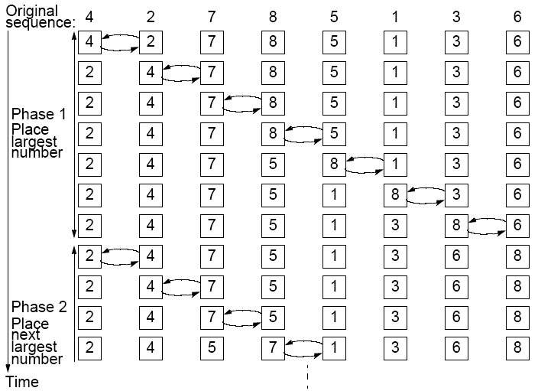

Slide 14

Time Complexity
Number of compare and exchange operations
Indicates a time complexity of O(n²) given that a single compare-and- exchange operation has a constant complexity, O(1).

Slide 15
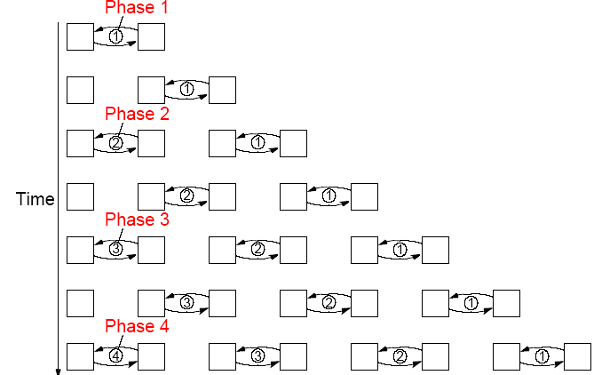
Parallel Bubble Sort
Iteration could start before previous iteration finished if does not overtake previous bubbling action:

Slide 16
Odd-Even (Transposition) Sort
Variation of bubble sort.
Operates in two alternating phases, even phase and odd phase.
Even phase
Even-numbered processes exchange numbers with their right neighbor.
Odd phase
Odd-numbered processes exchange numbers with their right neighbor.

Slide 17
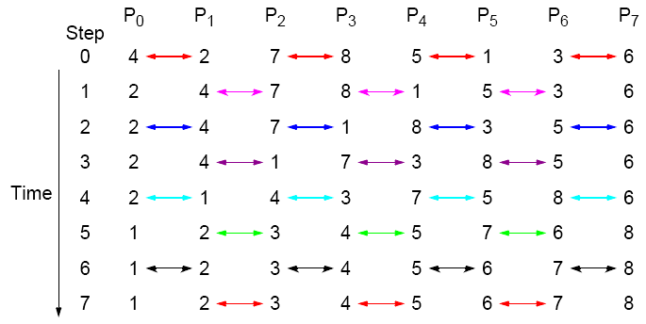
Odd-Even Transposition Sort
Sorting eight numbers

Slide 18
Mergesort
A classical sequential sorting algorithm using divide-and-conquer approach. Unsorted list first divided into half. Each half is again divided into two. Continued until individual numbers are obtained.
Then pairs of numbers combined (merged) into sorted list of two numbers. Pairs of these lists of four numbers are merged into sorted lists of eight numbers. This is continued until the one fully sorted list is obtained.

Slide 19
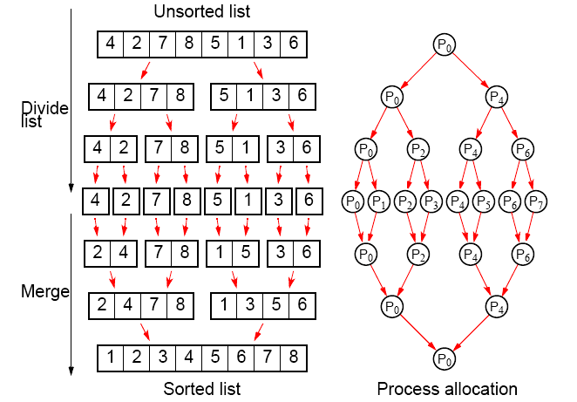
Parallelizing Mergesort
Using tree allocation of processes

Slide 20
Analysis
Sequential
Sequential time complexity is O(nlogn).
Parallel
2 log n steps in the parallel version but each step may need to perform more than one basic operation, depending upon the number of numbers being processed - see text.

Slide 21
Quicksort
Very popular sequential sorting algorithm that performs well with average sequential time complexity of O(nlogn).
First list divided into two sublists. All numbers in one sublist arranged to be smaller than all numbers in other sublist.
Achieved by first selecting one number, called a pivot, against which every other number is compared. If the number is less than the pivot, it is placed in one sublist. Otherwise, it is placed in the other sublist.
Pivot could be any number in the list, but often first number in list chosen. Pivot itself could be placed in one sublist, or the pivot could be separated and placed in its final position.

Slide 22
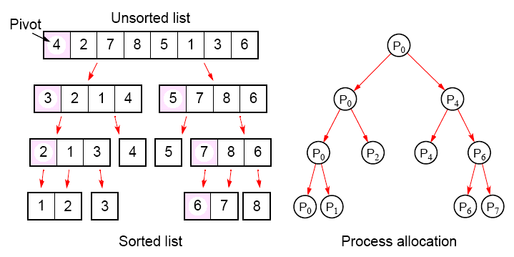
Parallelizing Quicksort
Using tree allocation of processes

Slide 23
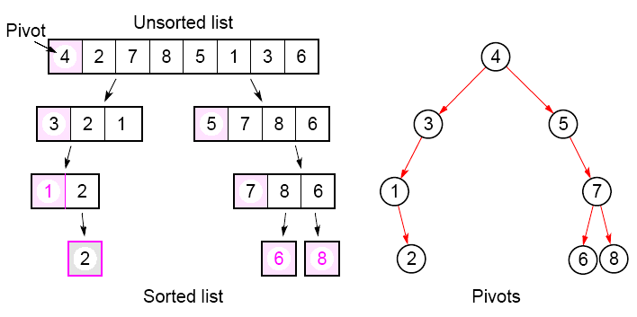
With the pivot being withheld in processes:

Slide 24
Analysis
Fundamental problem with all tree constructions – initial division done by a single processor, which will seriously limit speed.
Tree in quicksort will not, in general, be perfectly balanced Pivot selection very important to make quicksort operate fast.

Slide 25
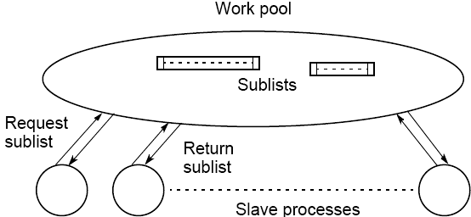
Work Pool Implementation of Quicksort
First, work pool holds initial unsorted list. Given to first processor which divides list into two parts. One part returned to work pool to be given to another processor, while the other part operated upon again.

Slide 26
Neither Mergesort nor Quicksort parallelize very well as the
processor efficiency is low (see book for analysis).
Quicksort also can be very unbalanced. Can use load balancing techniques.

Slide 27
Batcher’s Parallel Sorting Algorithms
• Odd-even Mergesort
• Bitonic Mergesort
Originally derived in terms of switching networks.
Both are well balanced and have parallel time complexity of O(log²n) with n processors.

Slide 28
Odd-Even Mergesort
Odd-Even Merge Algorithm
Start with odd-even merge algorithm which will merge two sorted lists into one sorted list. Given two sorted lists a₁, a₂, a₃, …, a_{n} and b₁, b₂, b₃, …, b_{n} (where n is a power of 2).

Slide 29
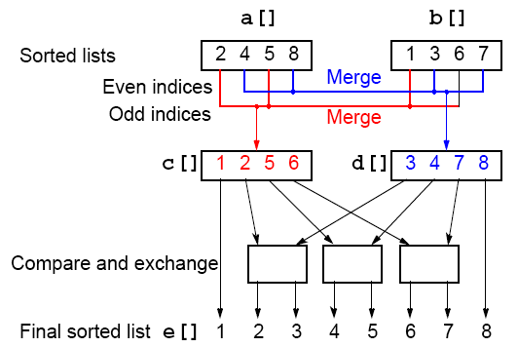
Odd-Even Merging of Two Sorted Lists

Slide 30
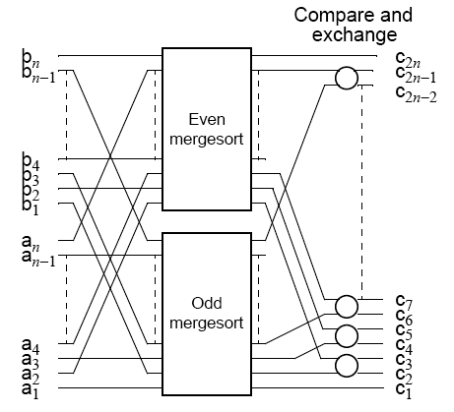
Odd-Even Mergesort
Apply odd-even merging recursively

Slide 31
Bitonic Mergesort
Bitonic Sequence
A monotonic increasing sequence is a sequence of increasing numbers.
A bitonic sequence has two sequences, one increasing and one decreasing. e.g.
a₀ < a₁ < a₂, a₃, …, a_{i-1} < a_{i} > a_{i+1}, …, a_{n-2} > a_{n-1}
for some value of i (0 <= i < n).
A sequence is also bitonic if the preceding can be achieved by shifting the numbers cyclically (left or right).

Slide 32
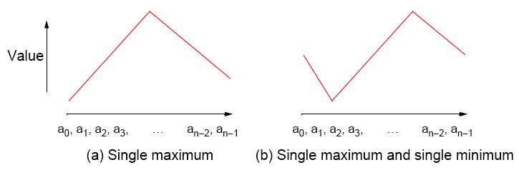
Bitonic Sequences

Slide 33
“Special” Characteristic of Bitonic Sequences
If we perform a compare-and-exchange operation on a_{i} with a_{i+n/2} for all i, where there are n numbers in the sequence, get TWO bitonic sequences, where the numbers in one sequence are all less than the numbers in the other sequence.

Slide 34
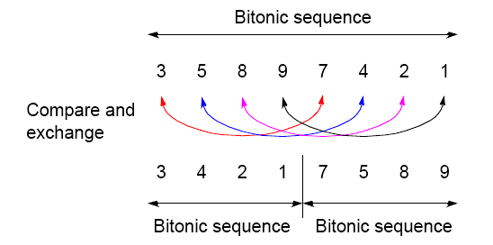
Creating two bitonic sequences from one bitonic sequence
Starting with the bitonic sequence
3, 5, 8, 9, 7, 4, 2, 1
we get:

Slide 35
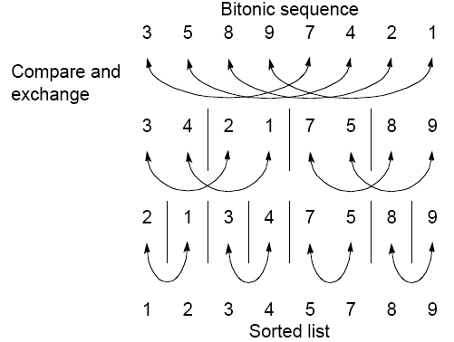
Sorting a bitonic sequence
Compare-and-exchange moves smaller numbers of each pair to left and larger numbers of pair to right. Given a bitonic sequence, recursively performing operations will sort the list.

Slide 36
Sorting
To sort an unordered sequence, sequences are merged into larger bitonic sequences, starting with pairs of adjacent numbers.
By a compare-and-exchange operation, pairs of adjacent numbers formed into increasing sequences and decreasing sequences. Pairs form a bitonic sequence of twice size of each original sequences.
By repeating this process, bitonic sequences of larger and larger lengths obtained.
In the final step, a single bitonic sequence sorted into a single increasing sequence.

Slide 37
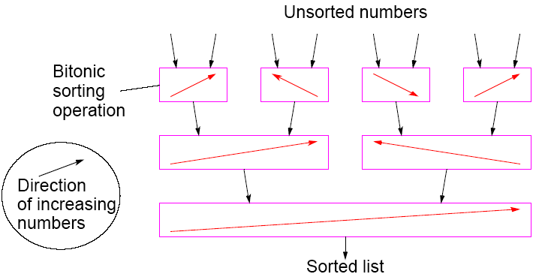
Bitonic Mergesort

Slide 38
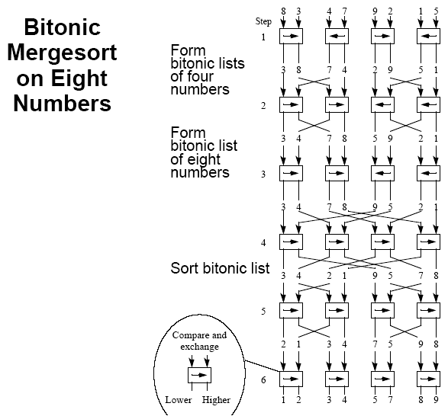

Slide 39
Phases
The six steps (for eight numbers) are divided into three phases:
Phase 1 (Step 1) Convert pairs of numbers into increasing/
decreasing sequences and into 4-bit
bitonic sequences.
Phase 2 (Steps 2/3) Split each 4-bit bitonic sequence into two
2-bit bitonic sequences, higher
sequences at center.
Sort each 4-bit bitonic sequence increasing/ decreasing sequences and merge into 8-bit bitonic sequence.
Phase 3 (Steps 4/5/6)Sort 8-bit bitonic sequence.

Slide 40

Number of Steps
In general, with n = 2^{k}, there are k phases, each of 1, 2, 3, …, k steps. Hence the total number of steps is given by

Slide 41
Sorting Conclusions so far
Computational time complexity using n processors
• Odd-even transposition sort - O(n)
• Parallel mergesort - O(n) but unbalanced processor load and Communication
• Parallel quicksort - O(n) but unbalanced processor load, and communication can generate to O(n²)
• Odd-even Mergesort and Bitonic Mergesort O(log²n)
Bitonic mergesort has been a popular choice for a parallel sorting.

Slide 42
Sorting on Specific Networks
Algorithms can take advantage of the underlying interconnection network of the parallel computer.
Two network structures have received specific attention: the mesh and hypercube because parallel computers have been built with these networks.
Of less interest nowadays because underlying architecture often hidden from user.
MPI features for mapping algorithms onto meshes, and one can always use a mesh or hypercube algorithm even if the underlying architecture is not the same.

Slide 43
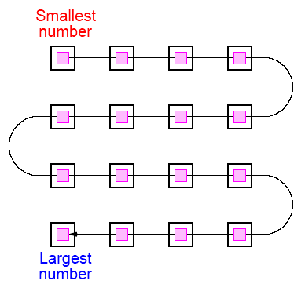
Mesh - Two-Dimensional Sorting
The layout of a sorted sequence on a mesh could be row by row or snakelike. Snakelike:

Slide 44
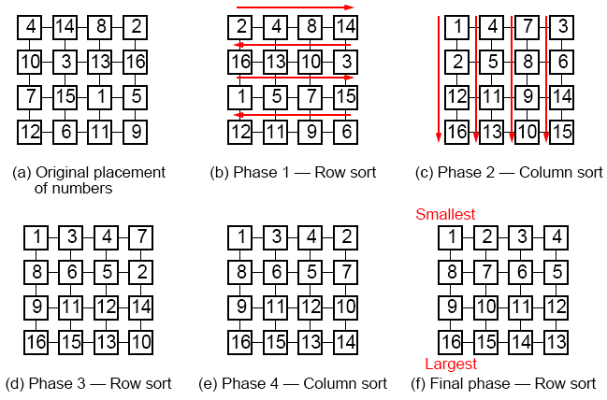
Shearsort
Alternate row and column sorting until list fully sorted. Row sorting
alternative directions to get snake-like sorting:

Slide 45
Shearsort

Slide 46
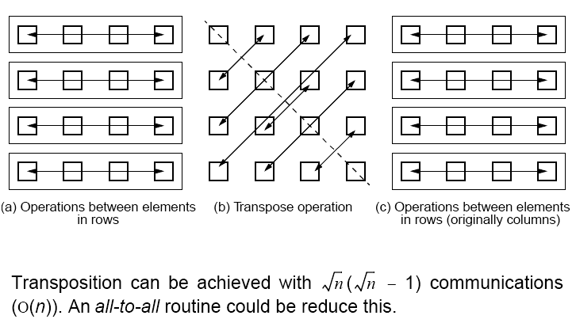
Using Transposition
Causes the elements in each column to be in positions in a row.
Can be placed between the row operations and column operations

Slide 47
Other Sorting Algorithms
We began by giving the lower bound for the time complexity of a sequential sorting algorithm based upon comparisons as O(nlogn).
Consequently, the time complexity of a parallel sorting algorithm based upon comparisons is O((logn)/p) with p processors or O(logn) with n processors.
There are sorting algorithms that can achieve better than O(nlogn) sequential time complexity and are very attractive candidates for parallelization but they often assume special properties of the numbers being sorted.

Slide 48
Rank Sort as basis of a parallel sorting algorithm
Does not achieve a sequential time of O(nlogn), but can be parallelized easily, and leads us onto linear sequential time algorithms which can be parallelized to achieve O(logn) parallel time and are attractive algorithms for clusters.

Slide 49
Rank Sort
Number of numbers that are smaller than each selected number counted. This count provides the position of selected number in sorted list; that is, its “rank.”
First a[0] is read and compared with each of the other numbers, a[1] … a[n-1], recording the number of numbers less than a[0].
Suppose this number is x. This is the index of the location in the final sorted list.
The number a[0] is copied into the final sorted list b[0] … b[n-1], at location b[x]. Actions repeated with the other numbers.
Overall sequential sorting time complexity of O(n²) (not exactly a good sequential sorting algorithm!).

Slide 50
Sequential Code
for (i = 0; i < n; i++) { /* for each number */
x = 0;
for (j = 0; j < n; j++) /* count number less than it */
if (a[i] > a[j]) x++;
b[x] = a[i]; /* copy number into correct place */
}
This code will fail if duplicates exist in the sequence of numbers. Easy to fix. (How?)

Slide 51
Parallel Code
Using n Processors
One processor allocated to each number. Finds final index in O(n) steps. With all processors operating in parallel, parallel time complexity O(n).
In forall notation, the code would look like
forall (i = 0; i < n; i++) { /* for each no in parallel*/
x = 0;
for (j = 0; j < n; j++) /* count number less than it */
if (a[i] > a[j]) x++;
b[x] = a[i]; /* copy no into correct place */
}
Parallel time complexity, O(n), as good as any sorting algorithm so far. Can do even better if we have more processors.

Slide 52
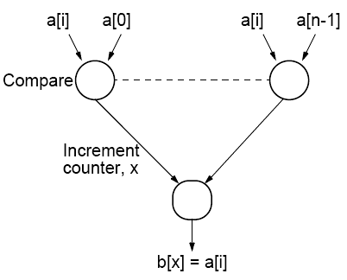
Using n² Processors
Comparing one number with the other numbers in list using multiple processors:
n - 1 processors used to find rank of one number. With n numbers, (n - 1)n processors or (almost) n² processors needed. Incrementing counter done sequentially and requires maximum of n steps. Total number of steps = 1 + n.

Slide 53
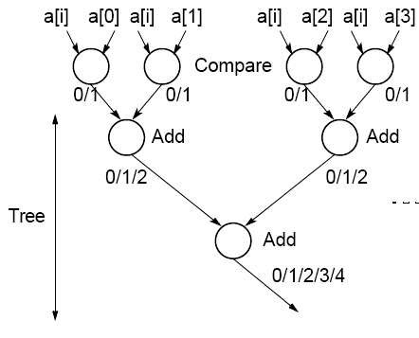
Reduction in Number of Steps
Tree to reduce number of steps involved in incrementing counter:
O(logn) algorithm with n² processors.
Processor efficiency relatively low.

Slide 54
Parallel Rank Sort Conclusions
Easy to do as each number can be considered in isolation.
Rank sort can sort in:
O(n) with n processors
or
O(logn) using n² processors.
In practical applications, using n² processors prohibitive.
Theoretically possible to reduce time complexity to O(1) by
considering all increment operations as happening in parallel since they are independent of each other.

Slide 55
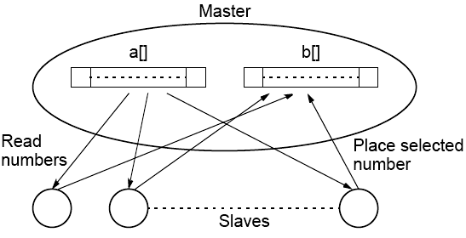
Message Passing Parallel Rank Sort
Master-Slave Approach
Requires shared access to list of numbers. Master process responds to request for numbers from slaves. Algorithm better for shared memory

Slide 56
Counting Sort
If the numbers to be sorted are integers, there is a way of coding the rank sort algorithm to reduce the sequential time complexity from O(n²) to O(n), called as Counting Sort.
As in the rank sort code suppose the unsorted numbers stored in an array a[] and final sorted sequence is stored in array b[]. Algorithm uses an additional array, say c[], having one element for each possible value of the numbers. Suppose the range of integers is from 1 to m. The array has element c[1] through c[m] inclusive. Now, let us working through the algorithm in stages.

Slide 57
Stable Sort Algorithms
Algorithms that will place identical numbers in the same order as in the original sequence.
Counting sort is naturally a stable sorting algorithm.

Slide 58
First, c[ ] will be used to hold the histogram of the sequence, that is, the number of each number. This can be computed in O(m) time with code such as:
for (i = 1; i <= m; i++)
c[i] = 0;
for (i = 1; i <= m; i++)
c[a[i]]++;

Slide 59
Next stage: The number of numbers less than each number found by performing a prefix sum operation on array c[ ].
In the prefix sum calculation, given a list of numbers, x₀, …, x_{n-1}, all the partial summations (i.e., x₀; x₀ + x₁; x₀ + x₁ + x₂; x₀ + x₁ + x₂ + x₃; … ) are computed.
Here, the prefix sum is computed using the histogram originally held in c[ ] in O(m) time as described below:
for (i = 2; i <= m; i++)
c[i] = c[i] + c[i-1];

Slide 60
Final stage: The numbers are placed in the sorted order in O(n) time as described below:
for (i = n; i >= 1; i--) {
b[c[a[i]]] = a[i]
c[a[i]]--; /* ensures stable sorting */
}
Complete code has O(n + m) sequential time complexity. If m is linearly related to n as it is in some applications, the code has O(n) sequential time complexity.

Slide 61
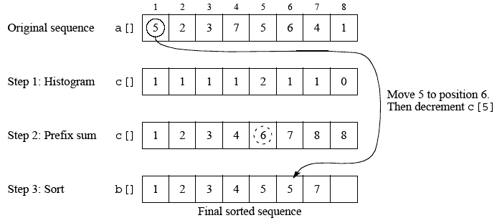
Counting sort

Slide 62
Parallelizing counting sort can use the parallel version of the prefix sum calculation which requires O(logn) time with n - 1 processors.
The final sorting stage can be achieved in O(n/p) time with p processors or O(1) with n processors by simply having the body of the loop done by different processors.

Slide 63
Radix Sort
Assumes numbers to sort are represented in a positional digit representation such as binary and decimal numbers. The digits represent values and position of each digit indicates their relative weighting.
Radix sort starts at the least significant digit and sorts the numbers according to their least significant digits. The sequence is then sorted according to the next least significant digit and so on until the most significant digit, after which the sequence is sorted. For this to work, it is necessary that the order of numbers with the same digit is maintained, that is, one must use a stable sorting algorithm.

Slide 64
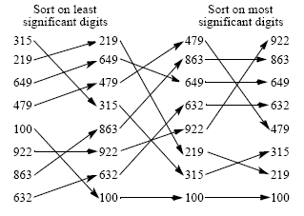
Radix sort using decimal digits

Slide 65
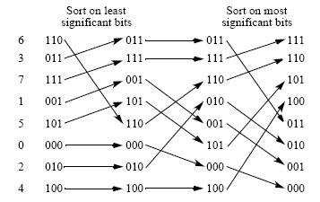
Radix sort using binary digits

Slide 66
Radix sort can be parallelized by using a parallel sorting algorithm in each phase of sorting on bits or groups of bits.
Already mentioned parallelized counting sort using prefix sum calculation, which leads to O(logn) time with n - 1 processors and constant b and r.

Slide 67
Using prefix sum calculation to sort digits
When prefix sum calculation applied to a column of bits, it gives number of 1’s up to each digit position because all digits can only be 0 or 1 and prefix calculation will simply add number of 1’s.
The prefix calculation on the digits inverted (diminished prefix sum) give the number of 0’s up to each digit.
When digit considered being a 0, diminished prefix sum calculation provides new position for number.
When digit considered being a 1, result of prefix sum calculation plus largest diminished prefix calculation gives final position for number.

Slide 68
Sample Sort
An old idea (pre1970) as are many basic sorting ideas.
Has been discussed in the context of quicksort and bucket sort.
In context of quicksort
Sample sort takes a sample of s numbers from the sequence of n numbers.
Median of this sample used as the first pivot to divide sequence into two parts as required as the first step by the quicksort algorithm rather than the usual first number in the list.

Slide 69
In context of bucket sort
Sample sort can divide ranges so that each bucket will have approximately the same number of numbers.
Picks out numbers from sequence of n numbers as splitters which define the range of numbers for each bucket. If there are m buckets, m - 1 splitters are needed.
Numbers are first divided into n/m groups.
Each group sorted and a sample of s equally spaced numbers chosen from each group.
Creates ms samples in total which are then sorted and m - 1 equally spaced numbers selected as splitters.

Slide 70
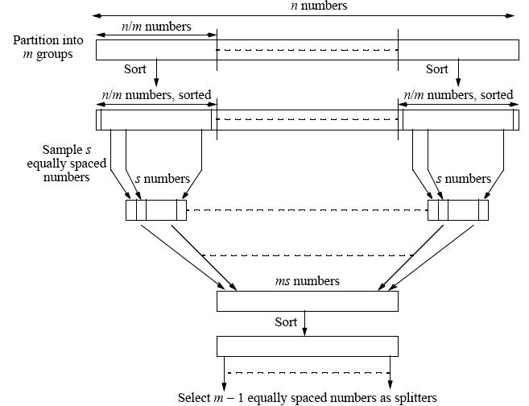
Selecting splitters
- Sample sort version of bucket sort

Slide 71
Sorting Algorithms on Clusters
Factors for efficient implementation on clusters:
Using collective operations such broadcast, gather, scatter, and reduce provided in message-passing software such as MPI rather than non-uniform communication patterns that require point-to-point communication, because collective operations expected to be implemented efficiently.
Using local operation - Distributed memory of a cluster does not favor algorithms requiring access to widely separately numbers.
Algorithms that require only local operations better, although all sorting algorithms finally have to move numbers in the worst case from one end of sequence to other somehow.

Slide 72
Cache memory -- better to have an algorithm that operate upon a block of numbers that can be placed in the cache. Will need to know the size and organization of the cache, and this has to become part of thealgorithm as parameters.
Clusters of shared memory processors -- algorithms need to take into account that the groups of processors may operate in the shared memory mode. Groups may intercommunicate in a message-passing mode.
To take this into account requires parameters such as number of processors within each shared memory system and size of the memory in each system.

